Slide 1


Cryptocurrency
By Team Ambassador

Slide 2
Team Ambassador

Slide 3
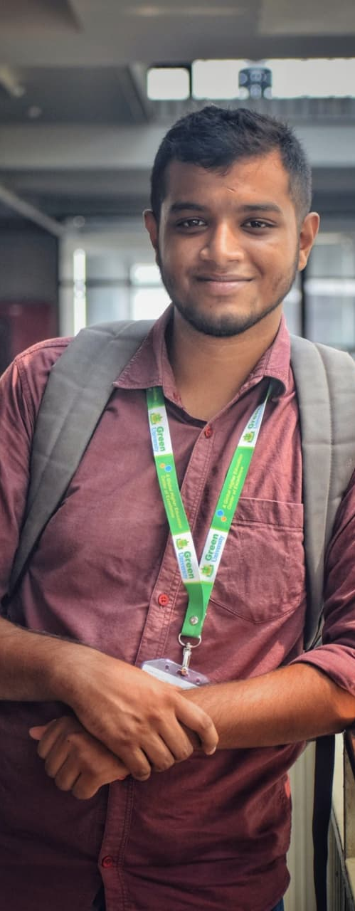
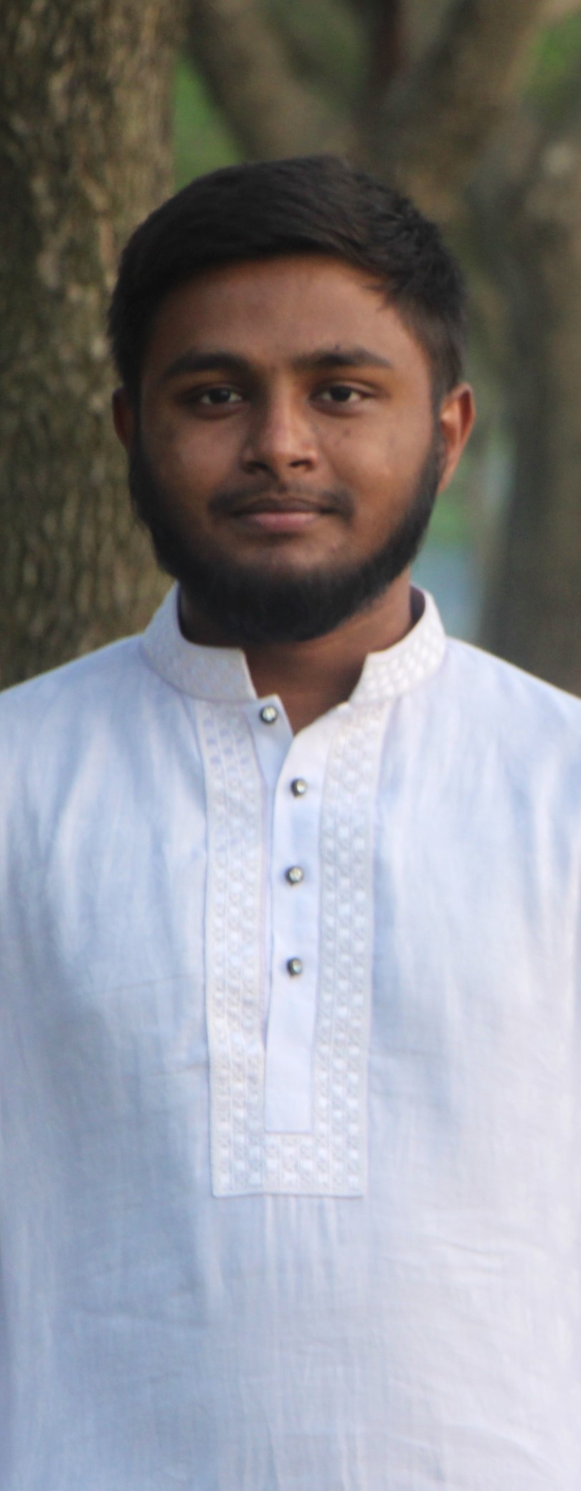
TEAM AMBASSADOR
Mohammad Nazmul Hossain
ID – 193902031 Batch - 193
Jonaed Hasan
ID – 193902029 Batch - 193

Slide 4

Cryptocurrency?
OUR Motivation
01
03
How Does it Works
OUR Project Preview
02
04

Slide 5
01
Cryptocurrency?
What is it?

Slide 6

Cryptocurrency?
Cryptocurrency is a relatively new type of money that operates in a completely different way than the traditional currency we all use every day. The most basic difference is that it’s exclusively a virtual currency, meaning there are no physical cryptocurrency coins or notes you can keep in your back pocket.

Slide 7

The birth of cryptocurrency.
Satoshi Nakamoto
&
Bitcoin

Slide 8

Motivation

Slide 9
30%
70%
People want to
Now people want to

Slide 10
How Does it Works
Satoshi Nakamoto was
the name
2008
2009
gaining popularity
more than 8,000
Cryptocurrency
2021
On May 3, 2014
NFT was introducing by Kevin McCoy

Slide 11
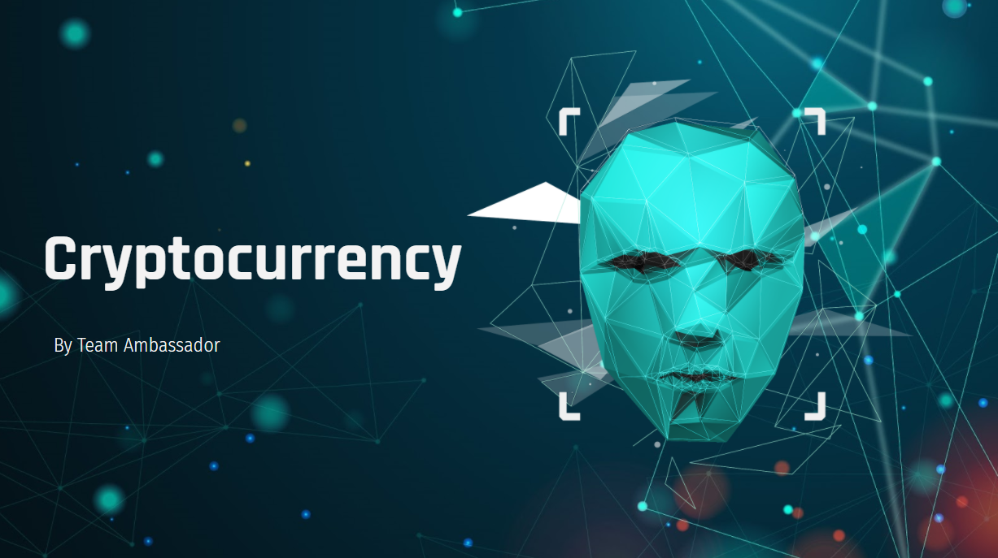
OUR Project Preview

Slide 12
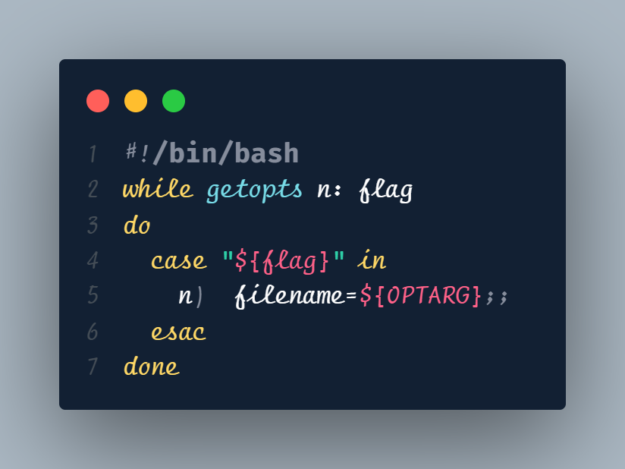

Slide 13
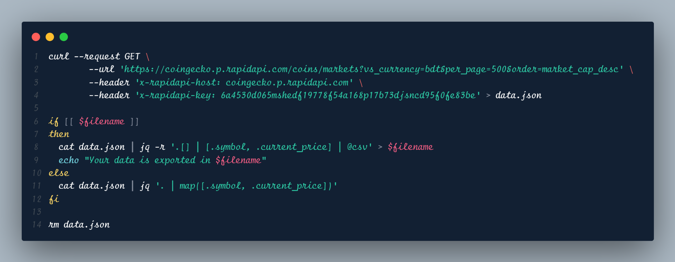

Slide 14
THANKS!
Do you have any questions?
Please keep this slide for attribution.

